Slide 1
Machine Learning for the Developer

Slide 2
Abstract
Part 1
Part 2
Azure Machine Learning Studio
[This was a 2018 topic]
Microsoft Toolkits, SDKs, and APIs
ML.NET
Accord
Azure Cognitive Services
How-to examples
Classification
Clustering
Regression
Neural Nets
Vision

Slide 3
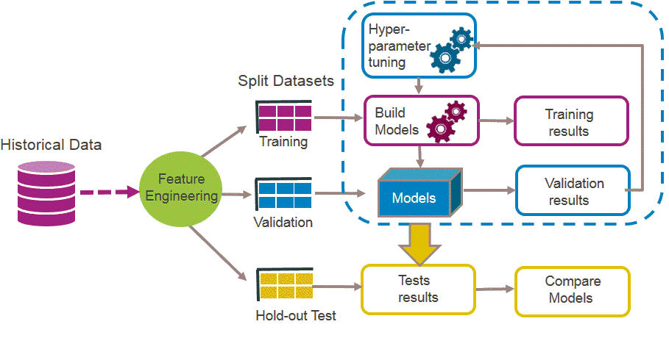
Machine Learning for the Developer – Part 1 (review)
Source: Machine Learning has transformed many aspects of our everyday life, can it do the same for public services?, Natalia Angarita , May 23, 2016, Capgemini https://www.capgemini.com/blog/insights-data-blog/2016/05/machine-learning-has-transformed-many-aspects-of-our-everyday-life

Slide 4
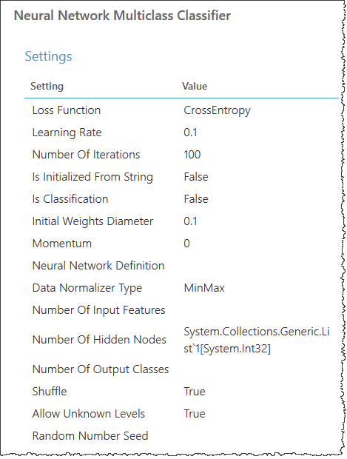
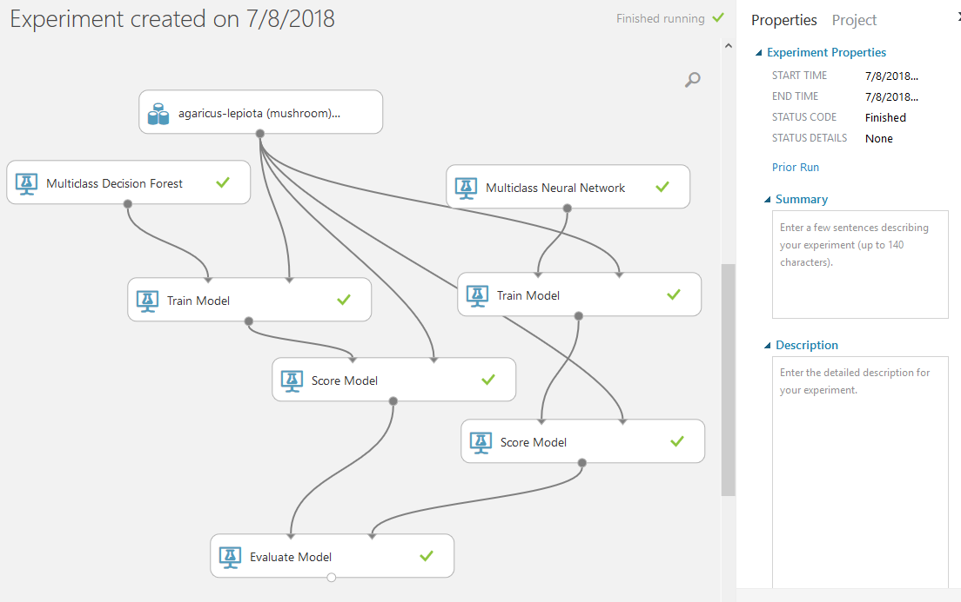
Machine Learning for the Developer – Part 1 (review)

Slide 5

ML.NET

Slide 6
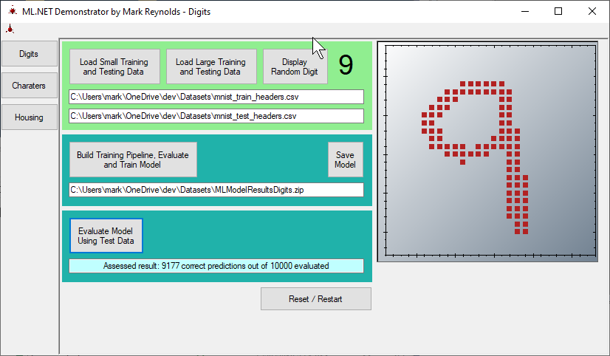
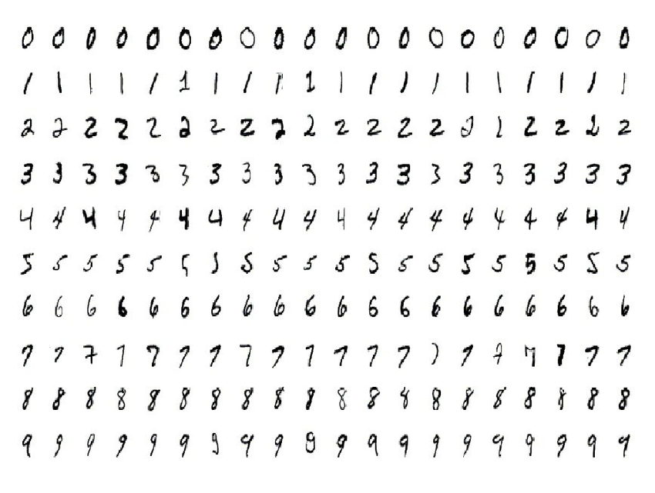
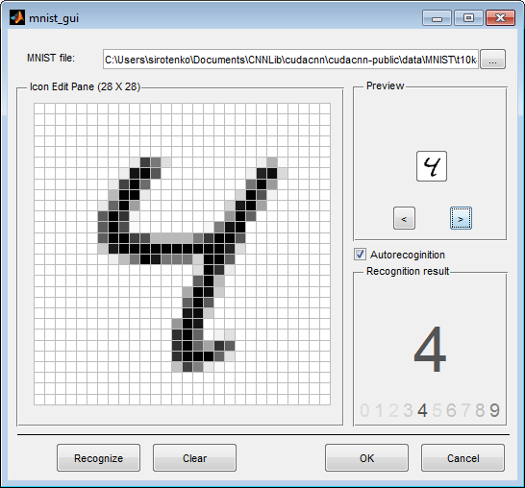
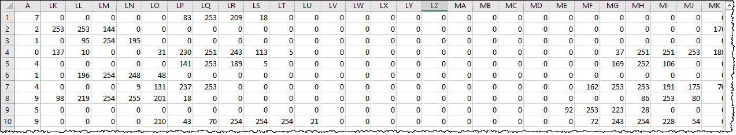
Examination of Source Data - Digits

Slide 7
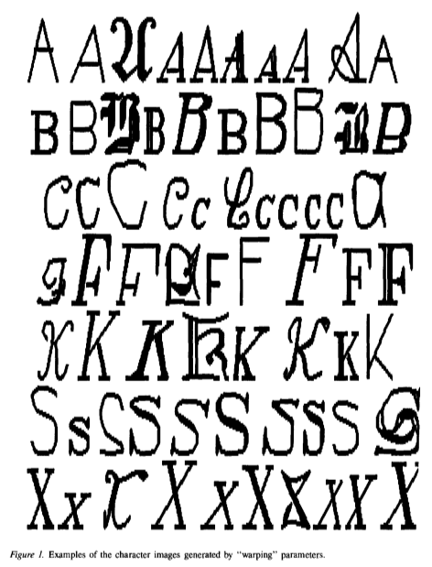
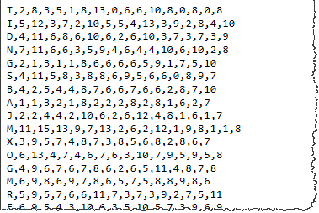
Letter Recognition Using Holland-style Adaptive Classifiers
Attribute Information:
lettr capital letter (26 values from A to Z)
x-box horizontal position of box (integer)
y-box vertical position of box (integer)
width width of box (integer)
high height of box (integer)
onpix total # on pixels (integer)
x-bar mean x of on pixels in box (integer)
y-bar mean y of on pixels in box (integer)
x2bar mean x variance (integer)
y2bar mean y variance (integer)
xybar mean x y correlation (integer)
x2ybr mean of x * x * y (integer)
xy2br mean of x * y * y (integer)
x-ege mean edge count left to right (integer)
xegvy correlation of x-ege with y (integer)
y-ege mean edge count bottom to top (integer)
yegvx correlation of y-ege with x (integer)
Source: http://archive.ics.uci.edu/ml/machine-learning-databases/letter-recognition/letter-recognition.names

Slide 8
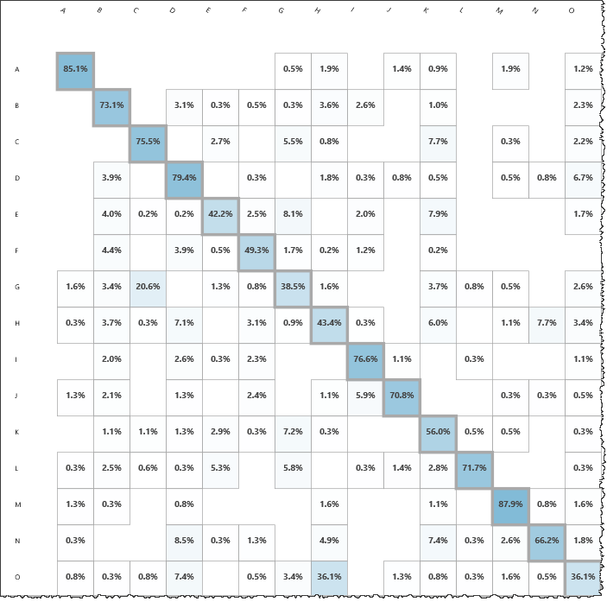
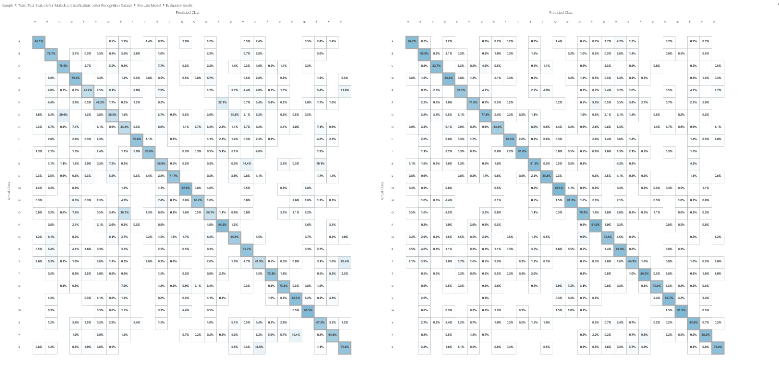
Letter Recognition Using Holland-style Adaptive Classifiers

Slide 9
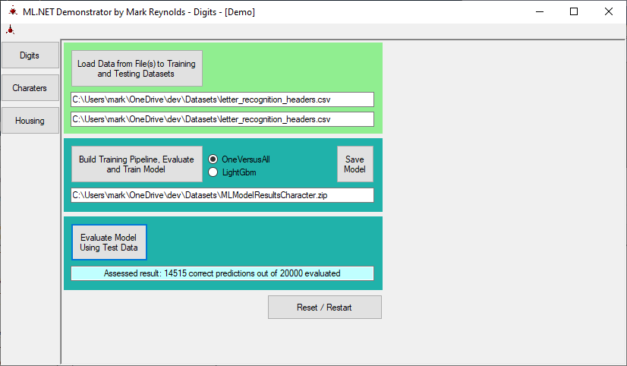
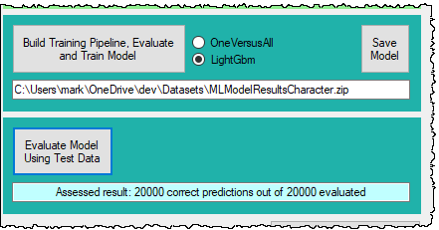
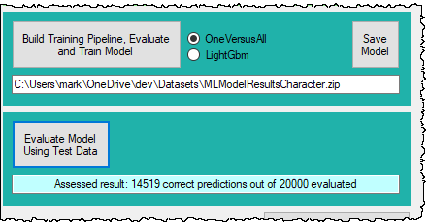
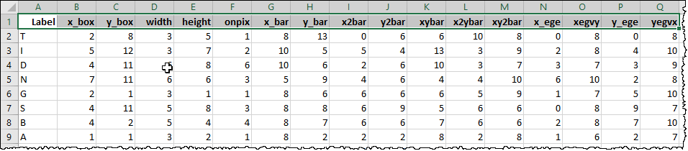
Examination of Source Data - Characters
lettr capital letter (26 values from A to Z)
x-box horizontal position of box (integer)
y-box vertical position of box (integer)
width width of box (integer)
high height of box (integer)
onpix total # on pixels (integer)
x-bar mean x of on pixels in box (integer)
y-bar mean y of on pixels in box (integer)
x2bar mean x variance (integer)
y2bar mean y variance (integer)
xybar mean x y correlation (integer)
x2ybr mean of x * x * y (integer)
xy2br mean of x * y * y (integer)
x-ege mean edge count left to right (integer)
xegvy correlation of x-ege with y (integer)
y-ege mean edge count bottom to top (integer)
yegvx correlation of y-ege with x (integer)
789 A
766 B
736 C
805 D
768 E
775 F
773 G
734 H
755 I
747 J
739 K
761 L
792 M
783 N
753 O
803 P
783 Q
758 R
748 S
796 T
813 U
764 V
752 W
787 X
786 Y 734 Z

Slide 10
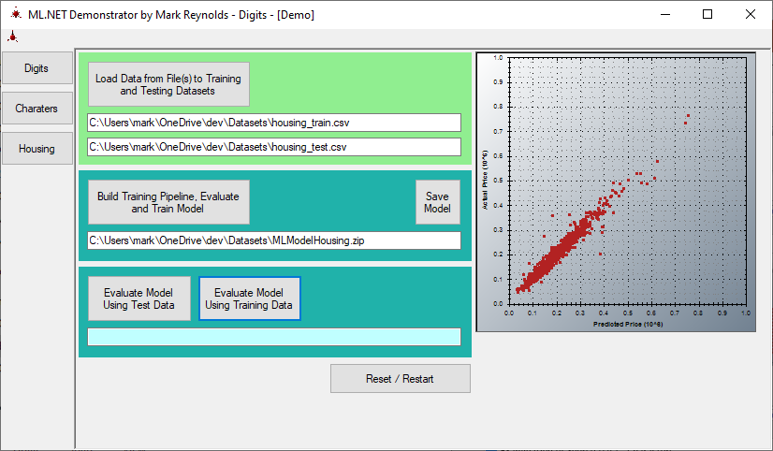
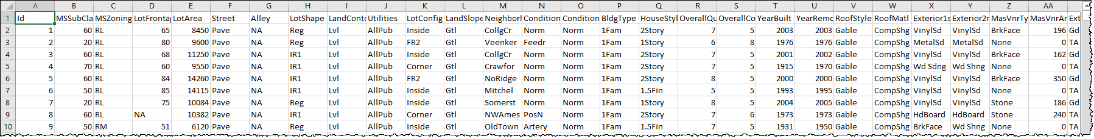
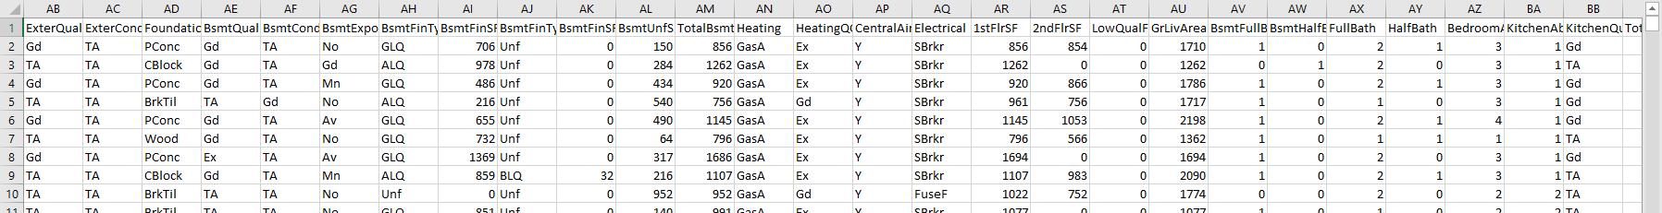
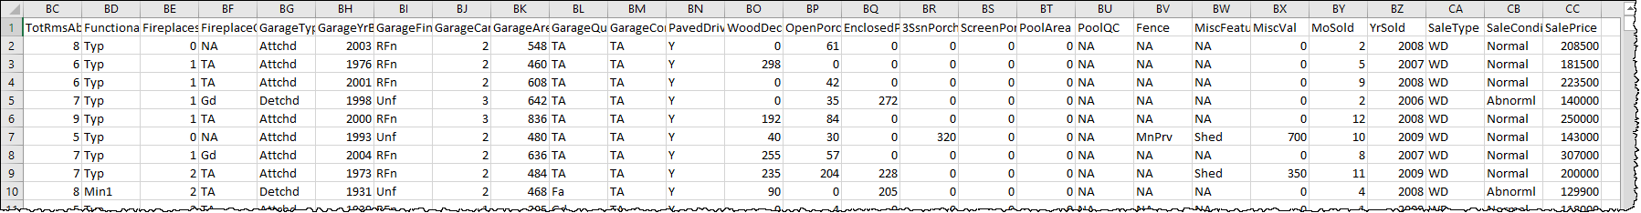
Examination of Source Data – Housing

Slide 11
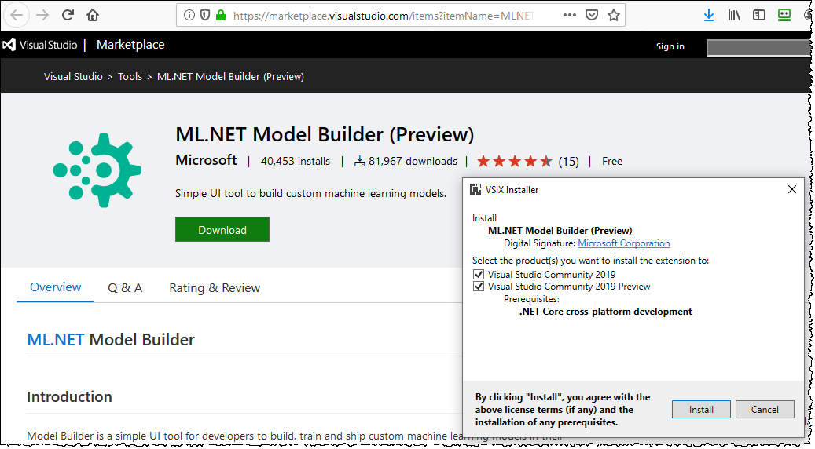
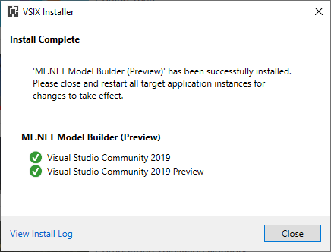
Getting Started with ML.NET – Install the Model Builder

Slide 12
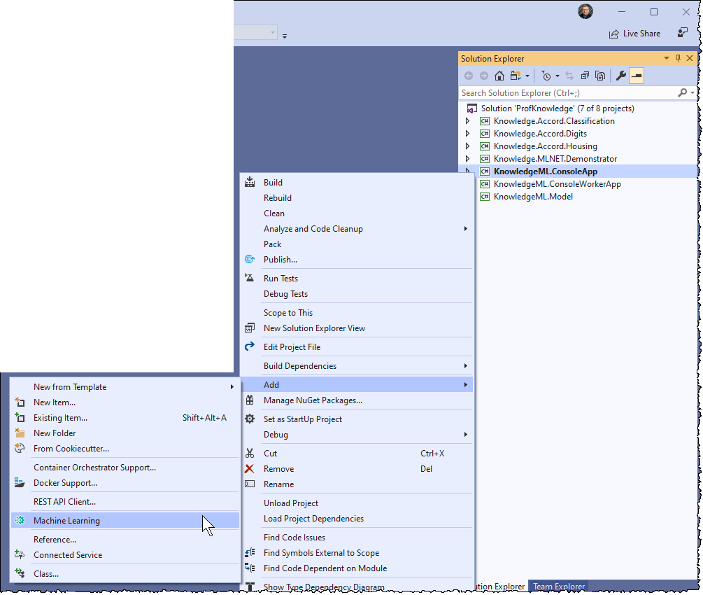
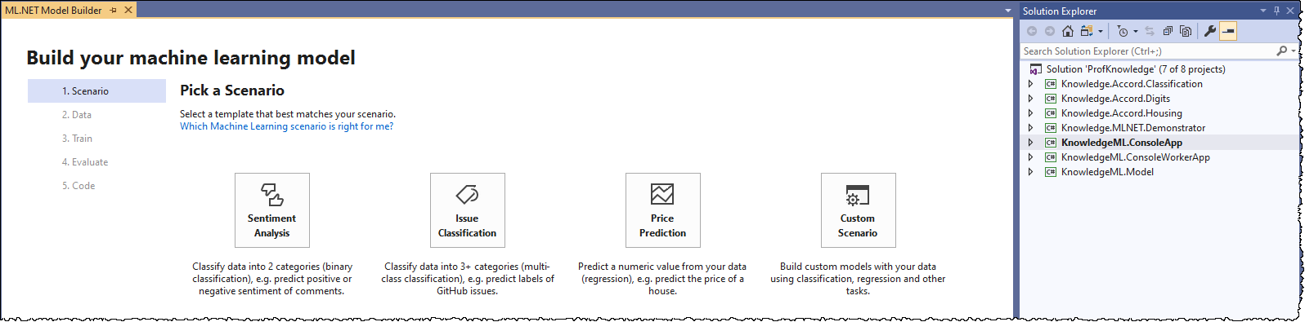
Getting Started with ML.NET – Add the Learning Model
Install the Machine Learning Model VSIX
Create a new Console App (.NET Core) (I used KnowledgeML.ConsoleApp)
Create the project
Add the Machine Learning Model

Slide 13
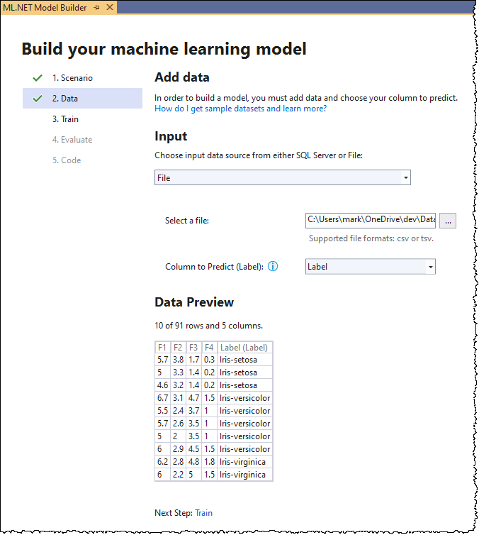
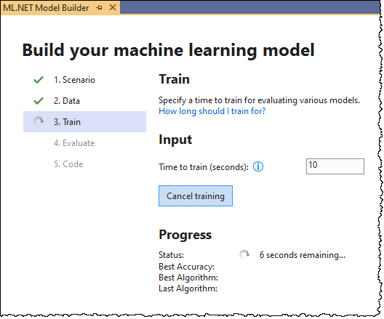
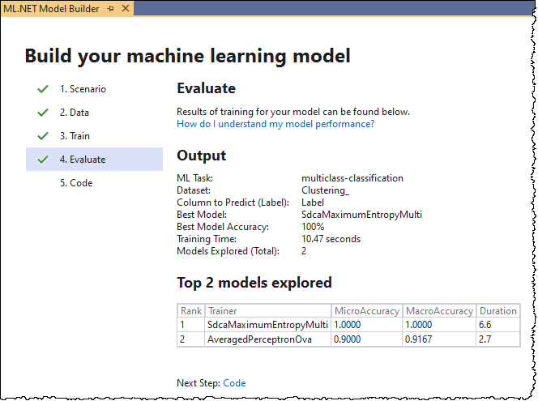
Getting Started with ML.NET – Build the Model

Slide 14
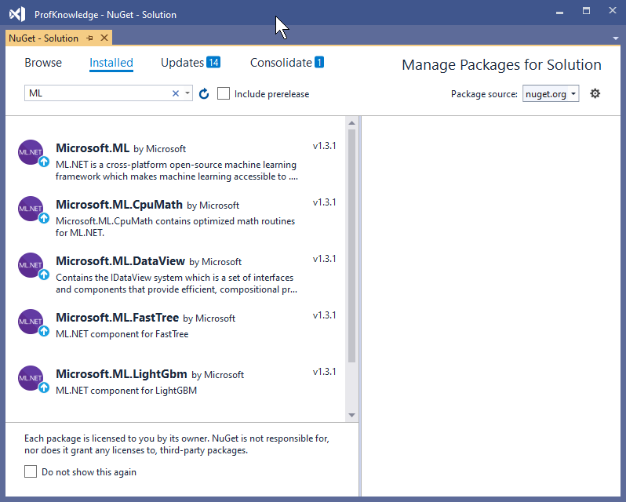
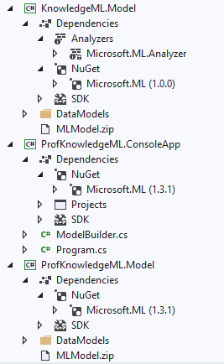
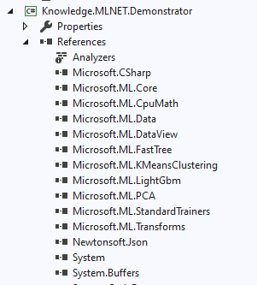
Getting Started with ML.NET – NuGet

Slide 15

ML.NET Live Demo
ModelBuilder.ConsoleApp
MLNET.Demonstrator

Slide 16
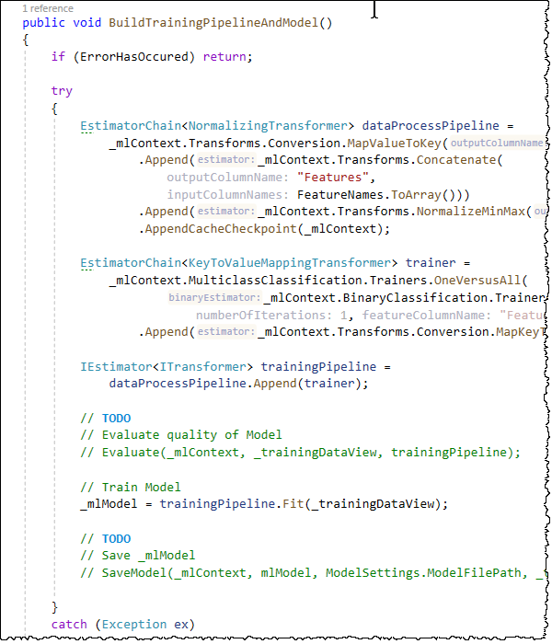
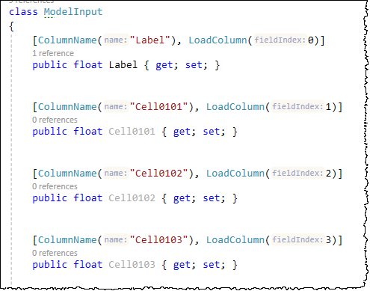
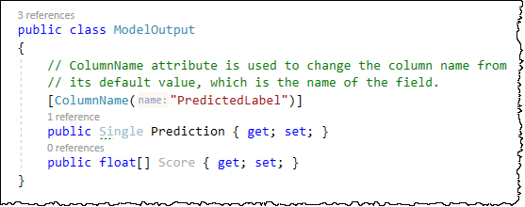
ML.NET Recap

Slide 17
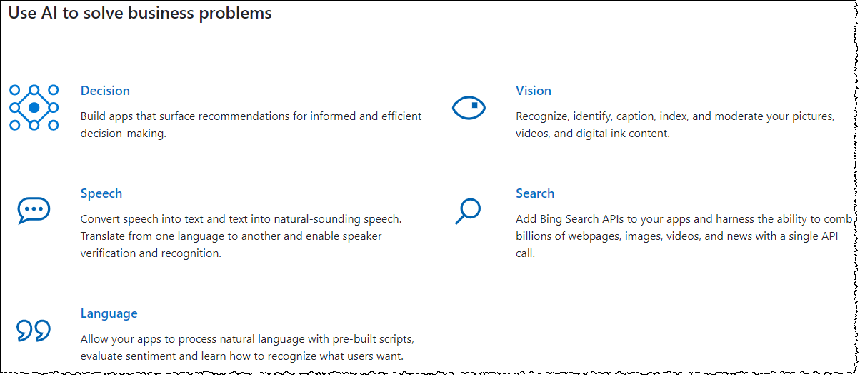
Azure Cognitive Services
Source: https://azure.microsoft.com/en-us/services/cognitive-services/

Slide 18
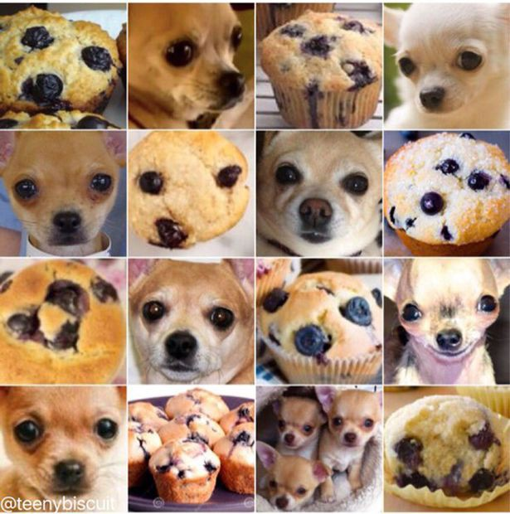
Chihuahua or Muffin?

Slide 19
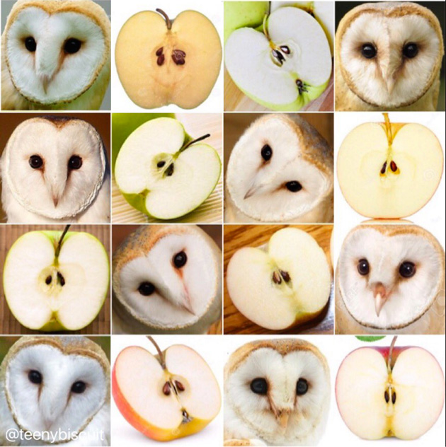
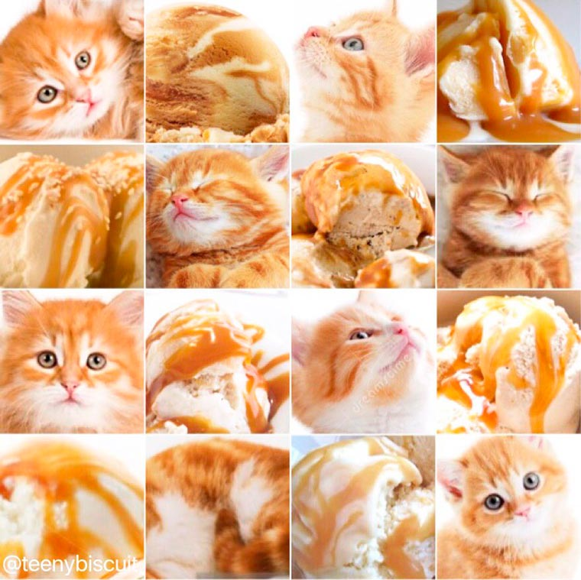
Barn Owl or Apple?
Kitten or Ice Cream?

Slide 20
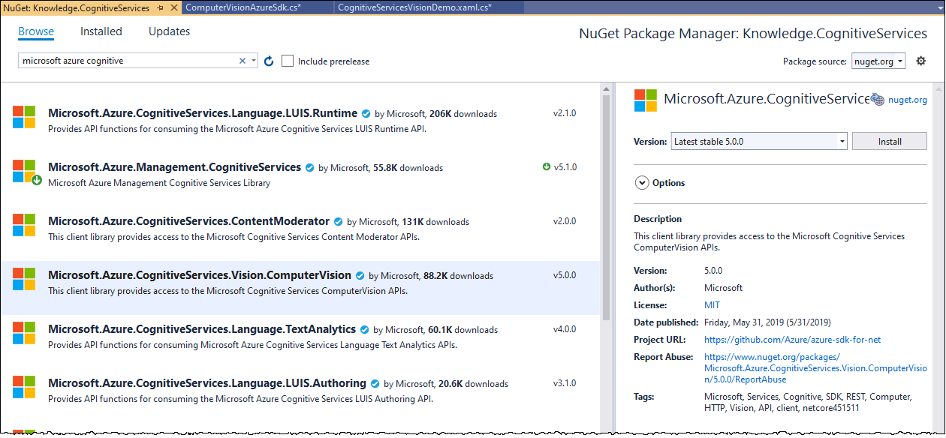
Azure Cognitive Services – Vision - NuGet

Slide 21
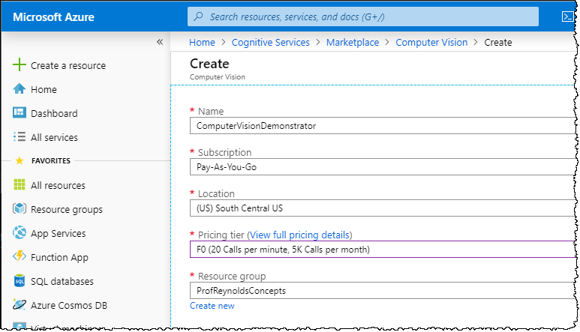
Azure Cognitive Services – Vision – Setup Azure Services

Slide 22
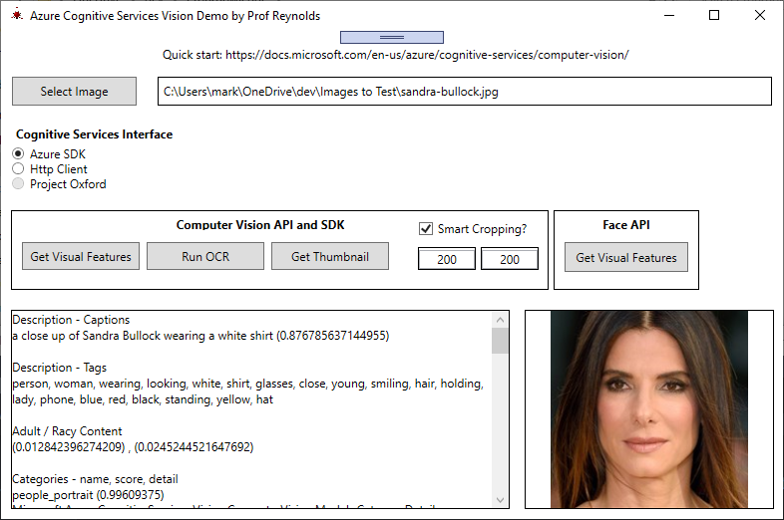
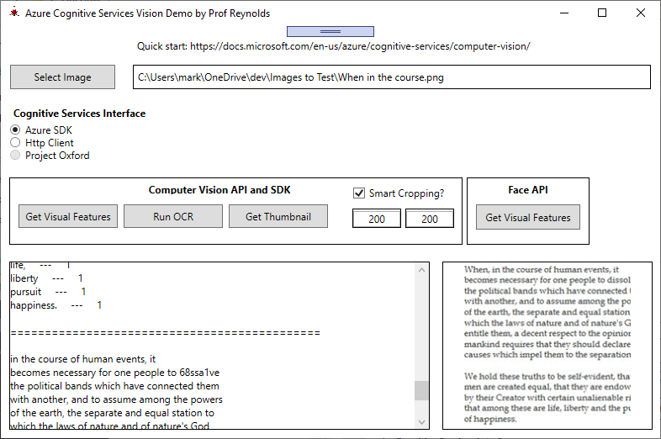
Azure Cognitive Services – Vision – As Implemented

Slide 23
Azure Cognitive Services, Vision – Live Demo
CognitiveServices.Demonstrator
CognitiveServices.VisionLibrary

Slide 24
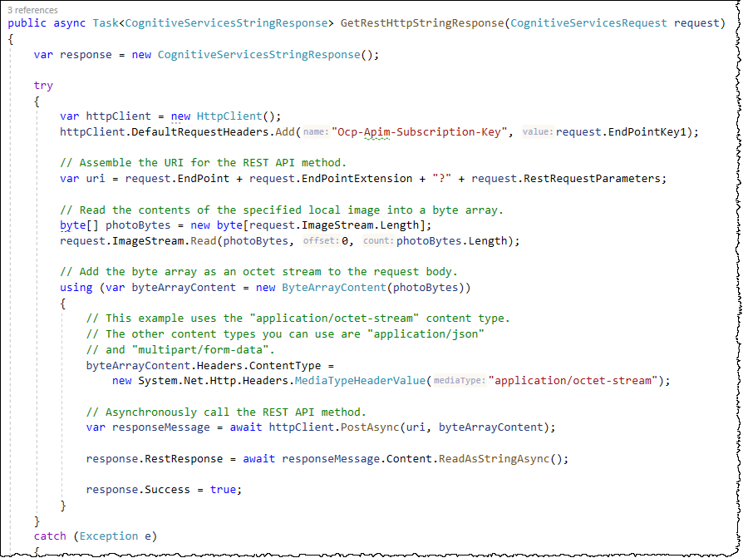
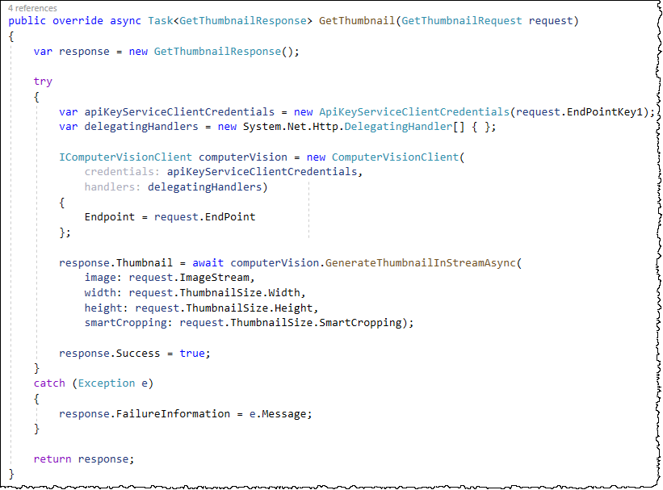
Azure Cognitive Services, Vision – Recap

Slide 25

Accord Framework

Slide 26
Accord Framework Live Demo
Knowledge.Accord.Digits

Slide 27
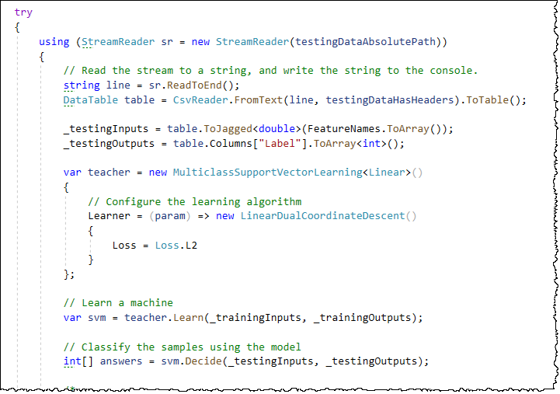
Accord Framework Recap

Slide 28
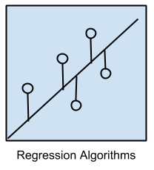
Regression Algorithms
Ordinary Least Squares Regression (OLSR)
Linear Regression
Logistic Regression
Stepwise Regression
Multivariate Adaptive Regression Splines (MARS)
Locally Estimated Scatterplot Smoothing (LOESS)
Source: https://machinelearningmastery.com/a-tour-of-machine-learning-algorithms/

Slide 29
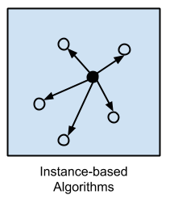
Instance-based Algorithms
k-Nearest Neighbor (kNN)
Learning Vector Quantization (LVQ)
Self-Organizing Map (SOM)
Locally Weighted Learning (LWL)
Source: https://machinelearningmastery.com/a-tour-of-machine-learning-algorithms/

Slide 30
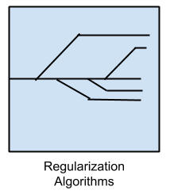
Regularization Algorithms
Ridge Regression
Least Absolute Shrinkage and Selection Operator (LASSO)
Elastic Net
Least-Angle Regression (LARS)
Source: https://machinelearningmastery.com/a-tour-of-machine-learning-algorithms/

Slide 31
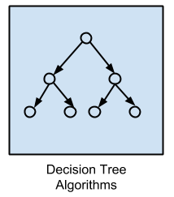
Decision Tree Algorithms
Classification and Regression Tree (CART)
Iterative Dichotomiser 3 (ID3)
C4.5 and C5.0 (different versions of a powerful approach)
Chi-squared Automatic Interaction Detection (CHAID)
Decision Stump
M5
Conditional Decision Trees
Source: https://machinelearningmastery.com/a-tour-of-machine-learning-algorithms/

Slide 32
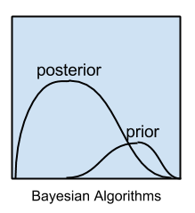
Bayesian Algorithms
Naive Bayes
Gaussian Naive Bayes
Multinomial Naive Bayes
Averaged One-Dependence Estimators (AODE)
Bayesian Belief Network (BBN)
Bayesian Network (BN)
Source: https://machinelearningmastery.com/a-tour-of-machine-learning-algorithms/

Slide 33
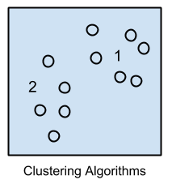
Clustering Algorithms
k-Means
k-Medians
Expectation Maximisation (EM)
Hierarchical Clustering
Source: https://machinelearningmastery.com/a-tour-of-machine-learning-algorithms/

Slide 34
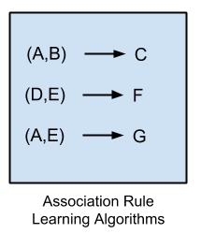
Association Rule Learning Algorithms
Apriori algorithm
Eclat algorithm
Source: https://machinelearningmastery.com/a-tour-of-machine-learning-algorithms/

Slide 35

Artificial Neural Network Algorithms
Perceptron
Back-Propagation
Hopfield Network
Radial Basis Function Network (RBFN)
Source: https://machinelearningmastery.com/a-tour-of-machine-learning-algorithms/

Slide 36

Deep Learning Algorithms
Deep Boltzmann Machine (DBM)
Deep Belief Networks (DBN)
Convolutional Neural Network (CNN)
Stacked Auto-Encoders
Source: https://machinelearningmastery.com/a-tour-of-machine-learning-algorithms/

Slide 37

Dimensionality Reduction Algorithms
Principal Component Analysis (PCA)
Principal Component Regression (PCR)
Partial Least Squares Regression (PLSR)
Sammon Mapping
Multidimensional Scaling (MDS)
Projection Pursuit
Linear Discriminant Analysis (LDA)
Mixture Discriminant Analysis (MDA)
Quadratic Discriminant Analysis (QDA)
Flexible Discriminant Analysis (FDA)
Source: https://machinelearningmastery.com/a-tour-of-machine-learning-algorithms/

Slide 38

Ensemble Algorithms
Boosting
Bootstrapped Aggregation (Bagging)
AdaBoost
Stacked Generalization (blending)
Gradient Boosting Machines (GBM)
Gradient Boosted Regression Trees (GBRT)
Random Forest
Source: https://machinelearningmastery.com/a-tour-of-machine-learning-algorithms/

Slide 39

And – Keep Your Eye on the Machine
Source: https://blogs.wsj.com/tech-europe/2011/04/26/for-sale-the-making-of-a-fly-only-23698655-93-plus-3-99-shipping/

Slide 40

About Mark Reynolds
Mark Reynolds Vitae
TBD
Southwestern Energy
Lone Star College
Intent Driven Designs
Scan Systems
Sikorsky Aircraft
General Dynamics
Personal Email: mark@ProfReynolds.com
Linkedin: www.linkedin.com/in/ProfReynolds
Twitter: @Prof_Reynolds
Blog: http://ProfReynolds.com

